Slide 1
Functions
12.12.13

Slide 2
Function
A special relation in which each member of the domain (x-value) is paired with exactly one member in the range.
Notes:
Label Domain and Range in the first picture
Go over function and not a function picture
Discuss function notation

Slide 3
Types of functions
Notes:
In Pre-Algebra, we are going to work with linear functions.

Slide 4
Is the relation a function?
Relation | Diagram | Is the Relation a Function?
{(-10,-34), (0,-22), (10,-9), (20,3)} | Domain(x) Range (y) -10 → -34 0 → -22 10 → - 9 20 → 3 | Yes, because each domain value is paired with exactly one range value
{(-10,-34), (-10,-22), (10,-9), (20,3)} | Domain(x) Range (y) -10 → -34 - 10 → -22 10 → - 9 20 → 3 | No, because -10 in the domain is pairec with two range values, -34 & -22.
Notes:
A relation is a set of ordered pairs
X Values canNOT repeat

Slide 5
Determine whether each relation is a function…
X | 5 | 3 | 2 | 0
Y | 1 | 3 | 1 | -2
Notes:
Yes, even though there are two y’s.

Slide 6
Is this a function?
(x,y)
(13,5) (-4,12) (6,0) (13,0)
Notes:
No, because 13 is paired with both 5 and 10 (cannot have two x’s)

Slide 7
x-Values (Inputs)
Domain:
Notes:
Domain: set for the independent variable. This is the set of #’s you choose from when evaluating an equation.
Usually time is an independent variable, like in the example graph.
These are the x-values or inputs.

Slide 8
y-Values (Outputs)
Range:
Notes:
Range: set for the dependent variable. These are the values you get when you evaluate an equation by substituting #’s from the domain.
This value of this variable depends upon another variable. For example distance in the graph depends on how much time has elapsed.
These are the y-values or outputs.

Slide 9
Functions can be represented 3 ways
y = 3x – 4
x | y
-1 | -7
0 | 4
1 | -1
2 | 2
7 | 17
Notes:
As equations, tables, and graphs are the 3 ways (label them above).
Show how the values in x/y table were created by plugging in values into the equation. This creates the graph then (graph with them the points)

Slide 10
Vertical Line Test
Notes:
Stress that it canNOT go through two points vertically in order to be a function.

Slide 11
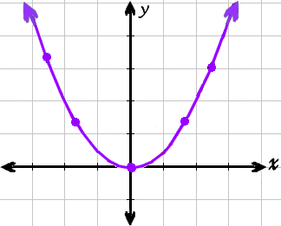
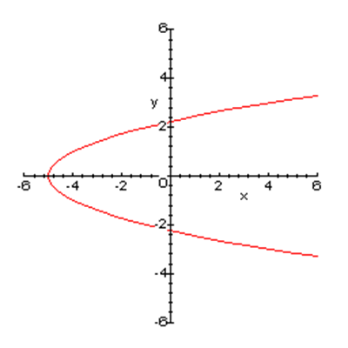
Use the Vertical Line Test
Notes:
First-yes
Second -no

Slide 12
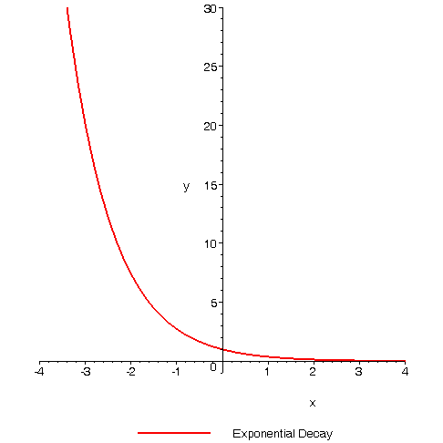
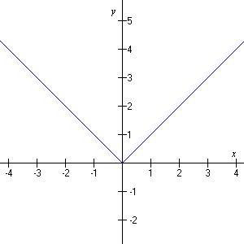
Is this a function?
Notes:
Both of these yes

Slide 13
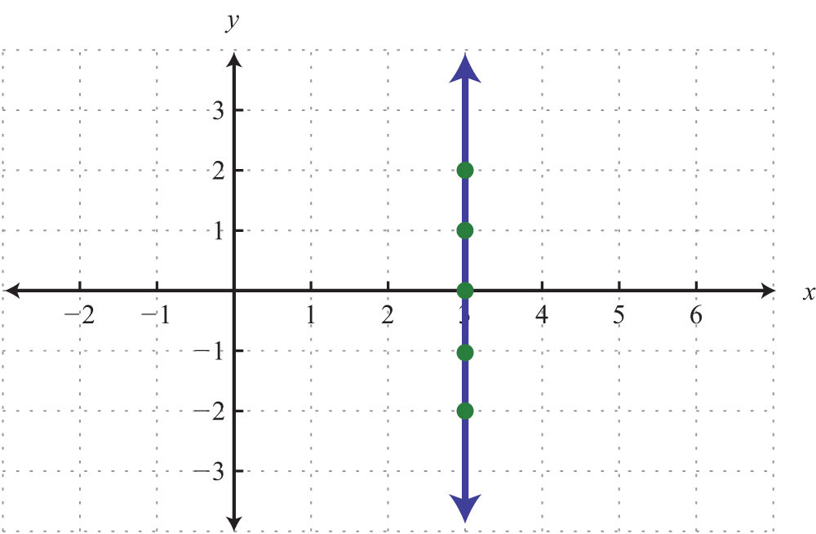
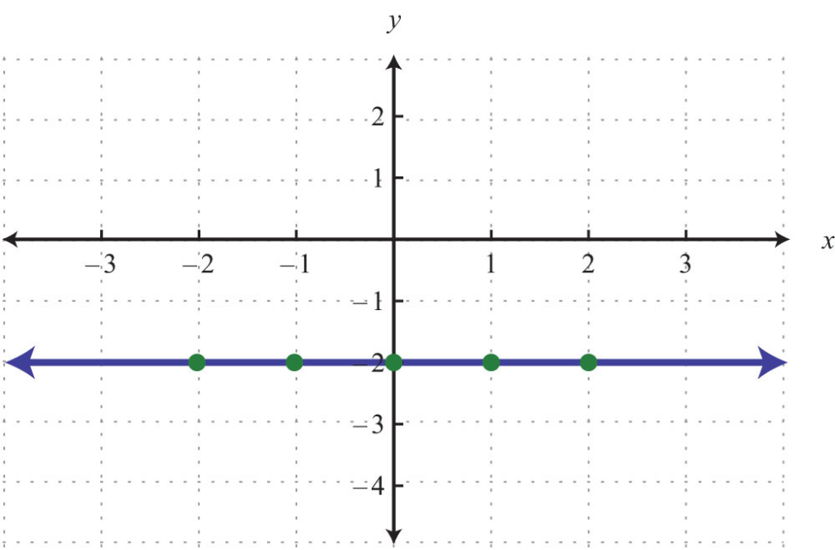
Is this a function?
Notes:
First- no
Second - yes

Slide 14
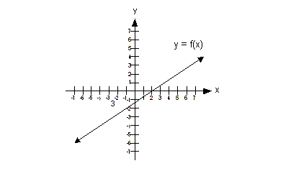
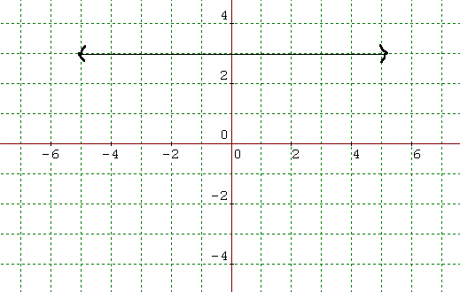
Is this is function?
Notes:
First - yes
Second – no (there is an extra dot below)

Slide 15
HW: p. 371-2 #12-27 ALL

